Slide 1
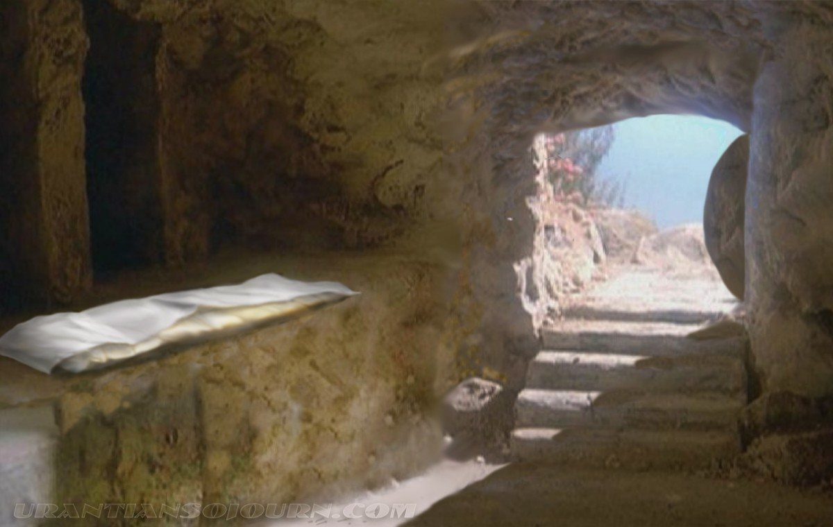

Slide 2
(Mark 16:1-8) Now when the Sabbath was past, Mary Magdalene, Mary the mother of James, and Salome bought spices, that they might come and anoint Him. (2) Very early in the morning, on the first day of the week, they came to the tomb when the sun had risen. (3) And they said among themselves, "Who will roll away the stone from the door of the tomb for us?"

Slide 3
(4) But when they looked up, they saw that the stone had been rolled away—for it was very large. (5) And entering the tomb, they saw a young man clothed in a long white robe sitting on the right side; and they were alarmed. (6) But he said to them, "Do not be alarmed.

Slide 4
You seek Jesus of Nazareth, who was crucified. He is risen! He is not here. See the place where they laid Him. (7) But go, tell His disciples—and Peter—that He is going before you into Galilee; there you will see Him, as He said to you." (8) So they went out quickly and fled from the tomb, for they trembled and were amazed. And they said nothing to anyone, for they were afraid.

Slide 5
GET OUTSIDE THE TOMB

Slide 6
GET OUTSIDE THE TOMB IN ORDER TO…
Enter Resurrection Light (Ephesians 2:1; 5:14)
Enjoy Resurrection Seating (Ephesians 2:5-6)
Experience Resurrection Life (Romans 6:4)
Employ Resurrection Power (Ephesians 1:19-20)
Embrace Resurrection Pursuit (Colossians 3:1)
Expect Resurrection Completion (1Thessalonians 4:16)
*Don’t waste resurrection life by staying in the tomb— get outside right now!

