Slide 1
THE WORD OF THE LORD BY HAGGAI THE PROPHET

Slide 2
ISRAEL’S HISTORY
United under Saul/David/Solomon (1043-931 BC)
Divided during reign of Rehoboam (931 BC)
Functioned as separate kingdoms from then on
Northern tribes (Israel) exiled to Assyria in 722 BC
Southern tribes (Judah) exiled to Babylon in 605 (Daniel)/597 (Ezekiel)/586 (temple destroyed) BC
Southern remnant returned to Judah 538 (Zerubbabel)/458(Ezra)/445 (Nehemiah) BC

Slide 3
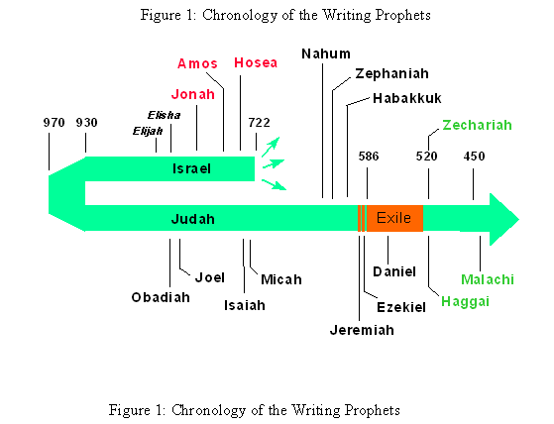

Slide 4
Political & Social Upheaval
722 BC Assyria conquers Israel & deports
612 BC Babylon conquers Assyria
605 BC Babylon deports some from Judah (Daniel)
597 BC Babylon deports more from Judah (Ezekiel)
586 BC Babylon destroys temple & deports
“times of the Gentiles” begins (Luke 21:24)
and ends with return of Christ

Slide 5
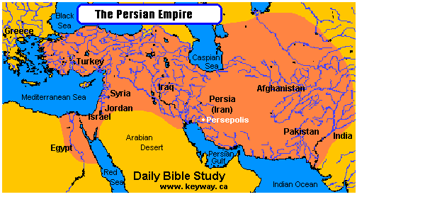

Slide 6
CHRONOLOGY OF HAGGAI
539 BC Persia conquers Babylon
538 BC Temple construction decreed by Cyrus (Ezra 1)
Return under Zerubbabel (Ezra 2)
536 BC Temple construction begins (Ezra 3)
534 BC Temple construction halted (Ezra 4)
520 BC Haggai’s ministry to returned remnant (Ezra 5)
Temple construction resumes (Ezra 6)
516 BC Temple construction completed (Ezra 6)

Slide 7
The Word of God is profitable for:
DOCTRINE
REPROOF
CORRECTION
INSTRUCTION IN RIGHTEOUSNESS

Slide 8
The Prophet’s Profit for Reproof
1:1-15 PRIORITY
Reproof = conviction through evidence presented
6/1
Evidence presented

Slide 9
Evidence Presented
EXHIBITS:
Their own words
The condition of the temple
Their ways
The Presence of the LORD

Slide 10
The Prophet’s Profit for Reproof
1:1-15
6/1
Reproof = conviction through evidence presented
Exhibits of evidence presented
Evidence presented reproved the remnant for their failed priority

Slide 11
The Prophet’s Profit for Reproof
Reproof = conviction through evidence presented
Does evidence reprove us for failed priority?
the church
--our words?
--condition of the church?
--our ways?
--God’s Presence?

Slide 12
The Prophet’s Profit for Correction
2:1-9 GLORY
Correction = restoration to a right state
7/21
Wrong thinking

Slide 13
Temple History
Solomon’s
Zerubbabel’s
Herod’s
Church age (believers individually & corporately)
Tribulation (Revelation11)
Millennial (Ezekiel)
Eternal (Revelation 21)

Slide 14
The Prophet’s Profit for Correction
2:1-9
7/21
Correction = restoration to a right state
Wrong thinking
Future…
Application…
--your body
--the Body of Christ

