Slide 1
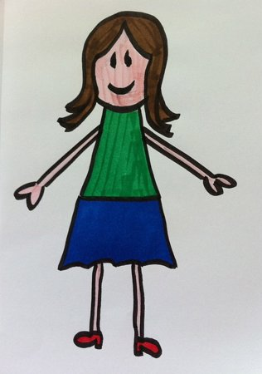

Slide 2
Now there were certain Greeks among those who came up to worship at the feast. Then they came to Philip, who was from Bethsaida of Galilee, and asked him, saying, "Sir, we wish to see Jesus.“ (John 12:20-21)

Slide 3
And beginning at Moses and all the Prophets, He expounded to them in all the Scriptures the things concerning Himself. (Luke 24:27)

Slide 4
SEEING JESUS IN JUDGES

Slide 5
CYCLE IN JUDGES
Israel forsakes God God judges Israel
Israel enjoys freedom Israel suffers
God provides deliverance Israel cries to God

Slide 6
SEEING JESUS IN JUDGES
JEPHTHAH
Judges 10-12

Slide 7
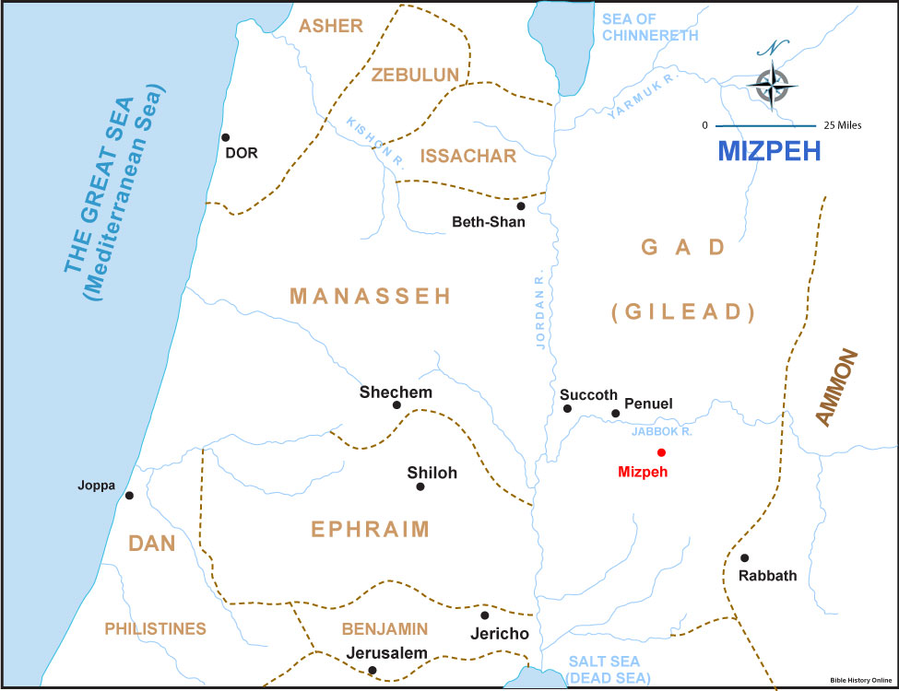

Slide 8
See Jesus in Jephthah because they both:
Entered extreme circumstances (10:6-18)
Exemplified mighty strength (11:1a)
Endured public shaming (11:1b)
Encountered family rejection (11:2)
Engaged known sinners (11:3)
Entertained leadership offers (11:4-11)
Employed Israel’s history (11:12-28)
Experienced the Spirit’s guidance (11:29)
Ensured costly sacrifice (11:30-31, 34-40)
Exercised victorious faith (11:32-33)
Executed rebellious rejectors (12:1-6)
Exited after completion (12:7)

Slide 9
Jesus is an infinitely better judge (Savior/Deliverer) than anyone
IS HE YOURS?
IF HE ISN’T, WHY NOT?
AND WHY NOT TRUST HIM AS SAVIOR TODAY?
IF HE IS, ARE YOU EXCITED ABOUT
SEEING HIM TODAY…
BY FAITH?
BY SIGHT?

Slide 11
“In those days there was
no king in Israel;
everyone did what was right
in his own eyes.”
Judges 21:25

Slide 12
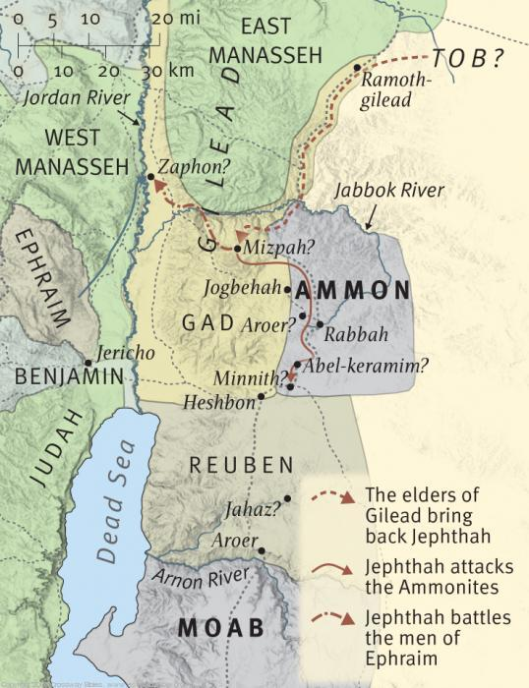

Slide 13
